Slide 1
Tugas MySQL Group By
M. Daffa Azriel Fernanda
http://www.free-powerpoint-templates-design.com

Slide 2
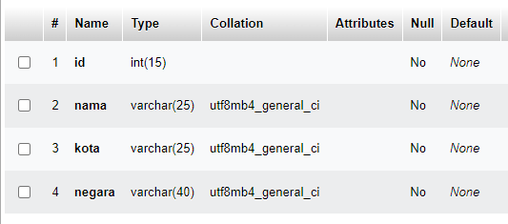
Section Break
Insert the Sub Title of Your Presentation

Slide 3
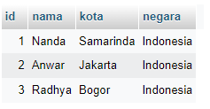
Data

Slide 4

PERINTAH SQL

Slide 5
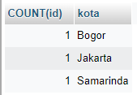
Hasil

